Slide 1

MEDICINAL STUDIES
A STEP TOWARDS PSORIASIS
ERADICATION

Slide 2
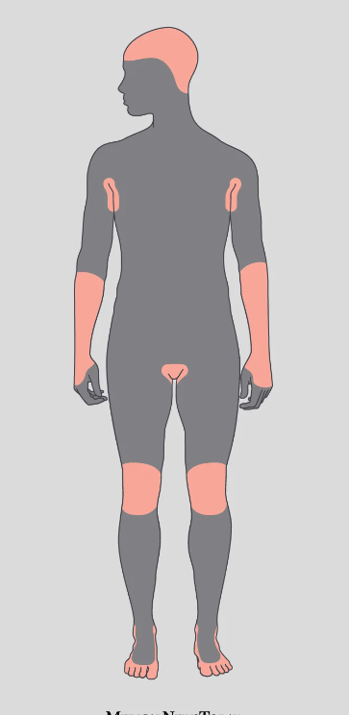
Disease
Name
WHY Psoriasis
?

Slide 3
What is Psorsis
Psoriasis is a chronic autoimmune condition that causes rapid skin cell production
Symptoms: Red, scaly patches on the skin, often itchy and sometimes painful.
Triggers: Stress, infections, skin injuries, certain medications.
CAN WE DEFEAT IT?
.
.
.
.
.
.
.
Common Areas: Scalp, elbows, knees, and lower back.
Causes: Genetic factors, immune system malfunction.
Treatment: Topical treatments, phototherapy, systemic medications.

Slide 4
Market Size

Slide 5

Psoriasis
Severity

Slide 6
Todays Objectives
Demonstration/Questions
Data
Clusters
Limitations
01
02
03
04
05
06
07
Review Breakdown
Feature Importance
The Future

Slide 7
The Data.
Side Effects
Med Type
Medicine
Dosage
Reviews

Slide 8
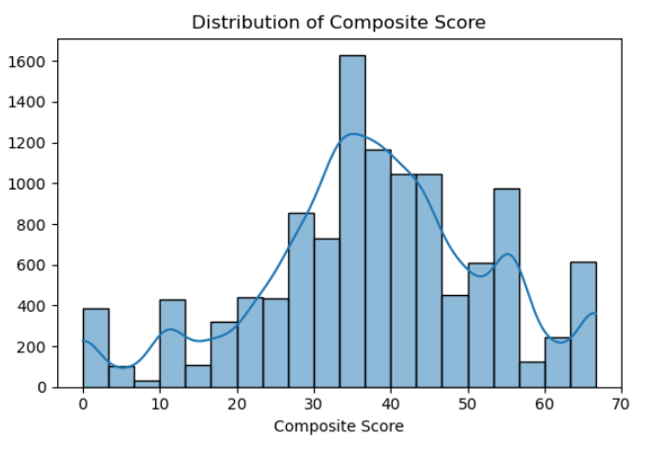
Reviews Breakdown

Slide 9
Side EFFECTS/ Word Clusters

Slide 10
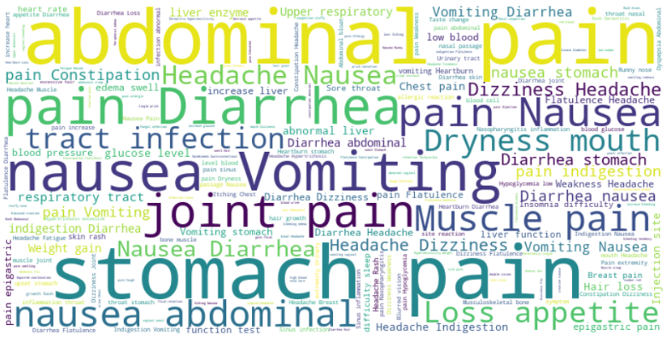
Word Cluster 1

Slide 11
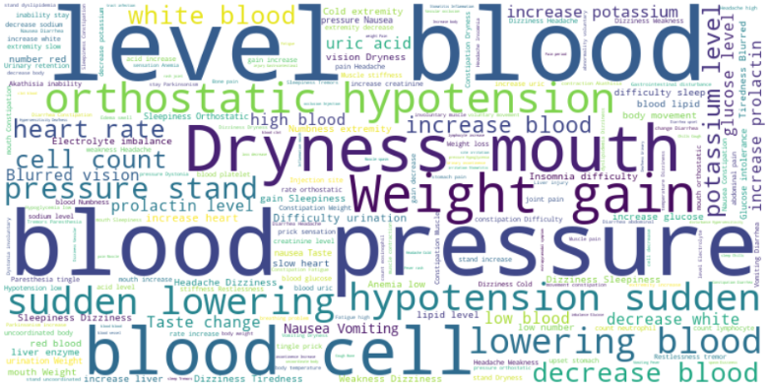
Word Cluster 2

Slide 12
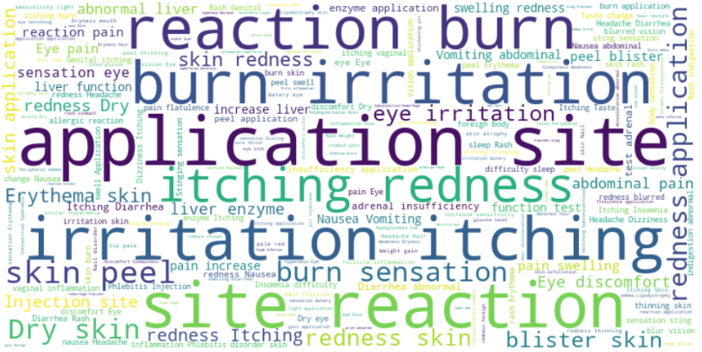
Word Cluster 3 !!!

Slide 13
Feature Importance
Are clusters the best way at determining the success of a drug ?

Slide 14
Conclusions

Slide 15





Limitations
Data Reliability
Weak Model
Lack of Features
Better Data?

Slide 16
Future Objectives
Manufacturing
Information
Natural Remedies
Deep Medicinal Data
Domain Exploration

Slide 17
Demo

Slide 18

Any Questions?

